Slide 1


Platform Engineering: Creating Scalable and Resilient Systems
This session covers platform engineering best practices and examples that will help engineering organizations build a strategy to deliver a consistent and automated experience, empowering teams to ship new functionality quickly, securely, and use cloud services as efficiently as possible.
Jason Cook | LinkedIn – Director Specialist Global Black Belt
Developer Productivity, AI & Platform Engineering

Slide 2

A few topics…
Understand pain points, goals and objectives
Share learnings & some of Microsoft’s journey
Three motions of Platform Engineering

Slide 3


Challenges with cloud operations at scale
Read this document on our common app foundations and shared app services. BTW – We’re introducing more in a few weeks.
Cloud operations team has strict requirements for applications. Read this documentation. We’ll need to do an audit before you can set up your dev environment.
We have weekly security office hours. We can discuss your needs there.
Cloud Ops
Our DevOps team is pretty booked. We can get you setup with a standard pipeline, but we will need to book a meeting to discuss your requirements.
Architecture
DevOps
Security
Other roles
?
Uh oh. Our management asked us to start
by the end of this week. What now?
How can we keep all this up to date as things change?
I just want to code.
?
?
Dev Lead
Notes:
6-8 weeks to get a new project started
Platform engineering is a practice, built up from DevOps principles,
that seeks to improve each development team’s security, compliance, costs, and time-to-business value
through improved developer experiences and self-service within a secure, governed framework.
It's both product-based mindset shift and a set of tools and systems to support it.

Slide 4
Common goals for Platform Engineering practices
Self-service with guardrails
Culture shift to product mentality
Self-service: keep developers focused on delivering business value quickly
Secure, governed development, but with team-level flexibility
Rapid, secure project and team member onboarding/offboarding
Simplified shared API, service discovery, adoption, publishing across teams
Improve collaboration while maintaining tool choice
Costs optimized across various tools, vendors, and teams
Engineering Platform managed as a product
Devs are the primary customer – automate away as much as possible
Security, architecture, operations are key stakeholders, provide input

Slide 5
A Bit About Microsoft’s Journey “1ES”
Notes:
As with other organizations, we’ve struggled to get our engineering group and teams aligned in the same direction

Slide 6
Provide a standardized, secure, and scalable foundation for software development teams
Microsoft’s Platform Engineering Journey
Notes:
1ES Mission
Or, simply, provide a standardized, secure and scalable foundation for software development teams.

Slide 7
The three traits of 1ES
Community across the company to help drive tooling, culture, and process learnings
Integrated and connected services promote reuse both internally and externally
Privacy, security, and accessibility standards are built into our workflow
Notes:
1ES is three things:​
A mission​
An engineering team building internal tools​
A set of shared objectives
1ES’s shared objectives include:
Building Community across the company​
Promoting reuse of tools and services both internally, and where it makes sense, externally​
Integrating compliance standards into the workflows
Mention Open source

Slide 8


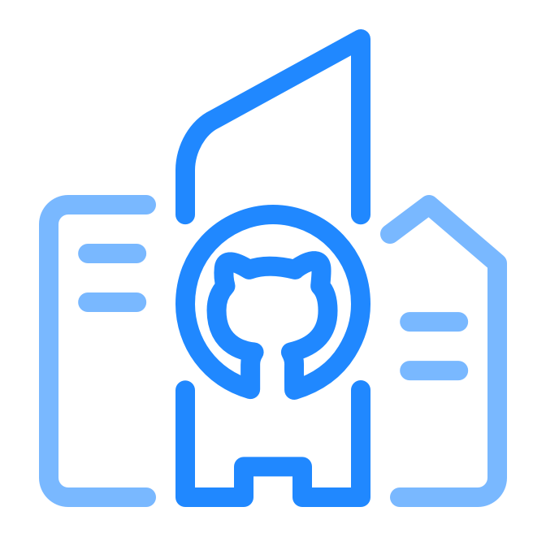
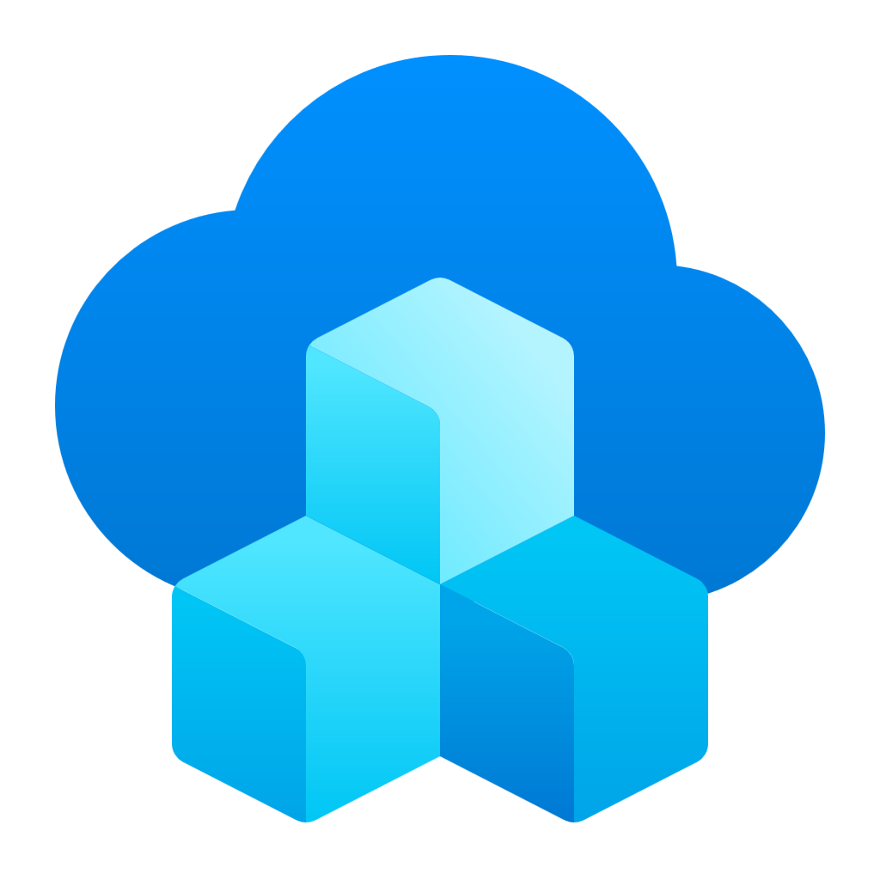


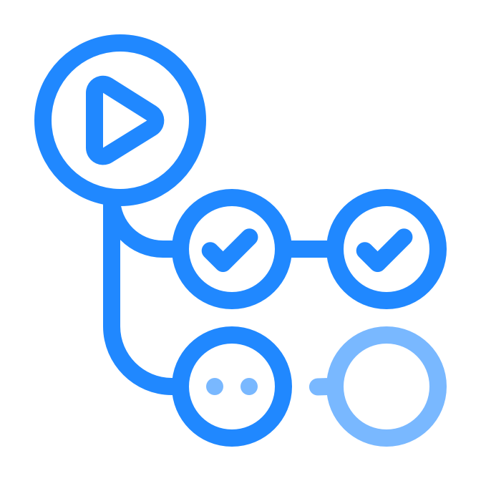

Microsoft’s internal Engineering Platform
Integrated developer experiences that improve productivity & satisfaction
Performance and security
@enterprise scale
App Developers
Local customizations
and Extensibility
Engineering Platform
Security, Platform Management and Integrated Experiences
Retail Microsoft Developer Products
Notes:
To do this we started with a base foundation of out developer tools…

Slide 9
Key aspects of an Engineering Platform
Developer self-service capabilities
Dev identity
Orchestration
& automation
Component &
API catalog
Team
insights
Dev UX
Languages
Source
APIs
Resources
Pipelines
Self-service
Templates
Web consumer
Web employee
Mobile consumer
Mobile employee
AI/Data Science
Service
IaC
…
Application
Platform
Runtime
Security & Governance
Continuous Improvement
Ops
Compute, Network
& Storage
K8s &
PaaS
Identity
& Secrets
Policies
& RBAC
Compliance
& Auditing
Usage Insights
Observe &
Experiment
Monitoring
& Incident Mgmt
Engineering
System
IC Dev
Collaboration
Continuous Integration & Deployment
IDE / Editor Dev Box
Source Code
Control
Sync & Async Collab
Work Item & Issue Tracking
Build
Security Scanning
Test
CD / GitOps
Notes:
From there we generalized this into key aspects of PE…

Slide 10
Platform Engineering Journey
Establish metrics that are key to your success at that stage.
Use these to distill insights that determine if, and when, to move to the next step.
Establish platform engineering “product team”
Inventory & centralization
Automate ”high toil” areas
Create a dedicated product team, which could be virtual, responsible for working across the organization to create a self-service developer platform.
Perform an inventory of existing tools, engineering systems, and application platforms. Evaluate usage to determine where to invest and candidates for deprecation. Begin centralizing and reducing redundancy.
Identify areas of high developer toil and automate them. These may be areas of “human in the loop” processes, etc.
Blaze paved paths
Deploy environments as a service
Optimize self- service developer experiences
Use templates to create “paved paths” that help developers “fall into the pit of success” by easily following organizational best practices --- orchestration.
Develop guardrails and ensure separation of concerns security, e.g. leverage techniques for “on-behalf-of” infrastructure provisioning to prevent over privileged access.
Create self-service with guardrails that are easy to consume, secure and are compliant by design. Platform is offered as a “product”.
Notes:
Through interacting with customers building a PE strategy we found that the work that needed to be done was grouped into several domains…
It’s also important to establish key metrics along the way to determine if and when to move onto other steps.

Slide 11
Eliminate unhelpful KPIs
Measure outcomes not, outputs:
Original estimate
Team burndown
Completed hours
Team velocity
Lines of code
# of bugs found
Team capacity
% code coverage
Notes:
It’s worth calling out that it’s important not to focus on traditional trailing metrics…

Slide 12
Metrics & KPIs
Customer usage
Pipeline throughput
Live-site health
Employee health
How much value are users getting?
Acquisition
Retention
Engagement
Satisfaction (NPS)
Feature usage
How efficient is the DevOps process?
Time to build
Time to test
Time to deploy
Time to improve
Failed and flakey automation
How quickly can you detect and fix issues?
Time to detect, time to communicate, time to mitigate
Customer impact, customer support metrics
Incident prevention items
Aging live-site problems
SLA per customer
How can you understand how employees are doing?
Monitor for burnout
Administer surveys to gather employee concerns
Track vacation time
Notes:
When measuring and quantifying outcomes, focus on the most critical and impactful key performance indicators (KPI)

Slide 13
How we measure Engineering Thrive
ES Satisfaction (NSAT) - A measure of satisfaction developers have with, “The engineering system you use at Microsoft”
Code Review Dwell Time - The delta between when a PR is created, and the when the first human acts on the code review
PR Completion Time - The delta between when a Pull Request is created and when it is successfully closed
Time-To-First-PR - The time between when a new hire starts Microsoft and when they complete their first PR.
Uninterrupted Focus Time - The amount of uninterrupted time a developer has for deep thinking and creative problem solving.
Employee Signals Thriving - The Thriving measure averages three items—Empowerment, Energy, Meaning.
Notes:
We’ve found a correlation between our operational efficiency as well as developer productivity with we call engineering thrive…
ES Satisfaction (NSAT)
What? A measure of satisfaction developers have with, “The engineering system you use at Microsoft”
Why? Recruitment and Retention:
Research has shown that engineering system (ES) satisfaction has a meaningful impact on our ability to recruit and retain our engineers.
Developers who are dissatisfied with their ES are more than 2x as likely to leave Microsoft within a year than those who are satisfied.
Customer Satisfaction:
Like any product, the ES wants satisfied customers (internal engineers at Microsoft).
Time To First Pull Request
What? The time between when a new hire starts Microsoft and when they complete their first Pull Request.
Why? New hires on teams with a faster time to first PR onboard 17% faster and have 15% longer retention. A fast first PR acts like a flywheel… New Hire developers who complete their first PR within 14 days have 66% higher PR throughput during their first 12 months.
Code Review Dwell Time
What? The delta between when a PR is created, and the when the first human acts on the code review
Why? Developers who report fast code-review turnaround times feel 20% more innovative than those with slow turnaround times.​
Pull Request Completion Time
What? The delta between when a Pull Request is created and when it is successfully closed
Why? Devs with a fast PR completion loop have 10% higher total change throughput than devs with slow loops.
Uninterrupted Focus Time
What? The amount of uninterrupted time a developer has for deep thinking and creative problem solving.*
Why? Developers who have a significant amount of time carved out for deep work feel 50% more productive than those lacking dedicated time. Microsoft engineers who reported an improved ability to focus during remote work were 2x as likely to report maintaining or improving their productivity. Developers do 78% more coding during formally scheduled “focus time” than during unscheduled blocks of time.

Slide 14
Platform Engineering Capability Model

Slide 15
Platform Engineering Capability Model – Matrix intro
Platform Engineering Capability Model
How are staff and funds allocated to platform capabilities? Budget and Staffing - Scope Management – Measuring ROI | Unfunded Immediate needs only How urgent requirements are addressed | Teams are created Linted to specific concerns Size of backlog | Central teams founded Solutions to address needs across teams Speed of delivery | Team is staffed / managed like product teams Product roadmaps defined with engineering teams Improvements in developer satisfaction | Central platform teams encourages contributions Knowledge sharing organization-wide Improvements in developer satisfaction
How do users discover your platform engineering solution? Discover - Choose - Use | Informally, word-of-mouth Engineers choose and integrate services Teams maintain their own scripts and tools | Platform team guidance Informal discussions with the platform team Processes built around platform standards | Platform team directives Platform team encourage use of platform capabilities Solutions are shared in informal communities | Platform self-service Look to the platform for technical solutions Use is supported through templates, forums, docs | Advocates and internal user community is built Platform engineers participate in planning Engineering teams contribute fixes / feature
How do you ensure your users have access to capabilities they need and that costs, data, and IP are appropriately managed? Define Policies - Monitor and Mitigate - Manage Access | A governance team defines policies for each team Incidents are addressed after they occur Permissions are granted based on immediate needs | Policy creation is manual and not standardized Basic auditing processes are established for key areas Some standard roles and permissions are established | Policies are standardized and centrally managed Monitoring, auditing of platform activities Access control is centralized and automated | Polices are regularly reviewed and refined Real-time monitor platform activities, quick detection Enforce least privilege, automated access reviews | Polices are refined based on advanced analytics Predictive analytics identify potential threats Context-aware access control adjust permissions
How do your users create, deploy, and manage resources? Provisioning - Manage Requests – Resource Allocation | Developers set up infrastructure Infrastructure requests are handled manually Rely on manual checks, when capacity issues arise | Some teams start using similar tools and scripts Centralized system, with manual provisioning by IT Standard tools for resource monitoring | Infrastructure as code (IaC) with templates and tools Handled with structure workflows using templates Centralized dashboards track resource allocation | Fully automated within CI / CD pipelines Self-service capability to provision resources Automated allocation based on patterns | Integrated into CI / CD pipelines based on needs Intelligent systems handle requests proactively Predict and respond to demand based on data
How do users interact with and consume platform capabilities? Setup Environment – Diagnose Application Behavior | Individual engineers set up environments Engineers choose their tools and processes | Teams define their own tools and processes Teams establish their own practices for diagnosing behavior | Required tools / processes defined in templates Standard practices are defined for diagnosing deployed resources | Knowledge sharing through discovery / modification of templates Tools and services for observing resources are provided on demand | Capabilities are integrated into tools teams already use (CLI, IDE) The platform automatically sets up observability for deployed applications
How do you gather and incorporate metrics and feedback and measure the success of your platform engineering practices? Measure Success - Collect/analyze Feedback – Engage Stakeholders | ROI measurement is fragmented Feedback collected informally, rarely analyzed Feedback is gathered from a limited user group | Measurements focus on process efficiency metrics Basic channels established, but consistency varies Dedicated individuals start managing feedback | Outcome-based metrics like developer productivity Formalized collection, standard metrics like DORA Review sessions are held with cross-functional teams | Access impact on outcomes like revenue growth Feedback collection embedded in development Shareholders involved in the feedback process | The organization leverages predictive analytics Feedback collection embedded in development A culture of feedback is established
Key Drivers / Stages
Initial
Repeatable
Defined
Managed
Optimizing
Investment
Adoption
Governance
https://aka.ms/PECapabilitySurvey
Provisioning and Management
Interfaces
Measurements and Feedback
Notes:
We believe this model can help organizations concentrate on developing the specific abilities and competencies they need to achieve their platform engineering goals.
It provides the ability to reflect and assess where you are, gives you line of site to where you would like to be, and a mechanism to help prioritize your activities.
Key drivers and inflection points…

Slide 16
Platform Engineering Capability Model – Summary
Platform Engineering Capability Model
Emerging Innovators
Focused on rapid product development and growth, they invest in products and use manual processes with limited automation. They rely heavily on people to solve problems.
Strategic Builders
Aimed at improving efficiency and cutting costs, they establish policies that enhance operational effectiveness and use automation for scaling issues. However, they haven't fully integrated platform engineering solutions like self-service.
Platform Pioneers
They enhance the developer experience and expand platform capabilities, treating the platform as a product with robust self-service systems. Their approach seamlessly supports developers' workflows.
https://aka.ms/PECapabilitySurvey

Slide 17
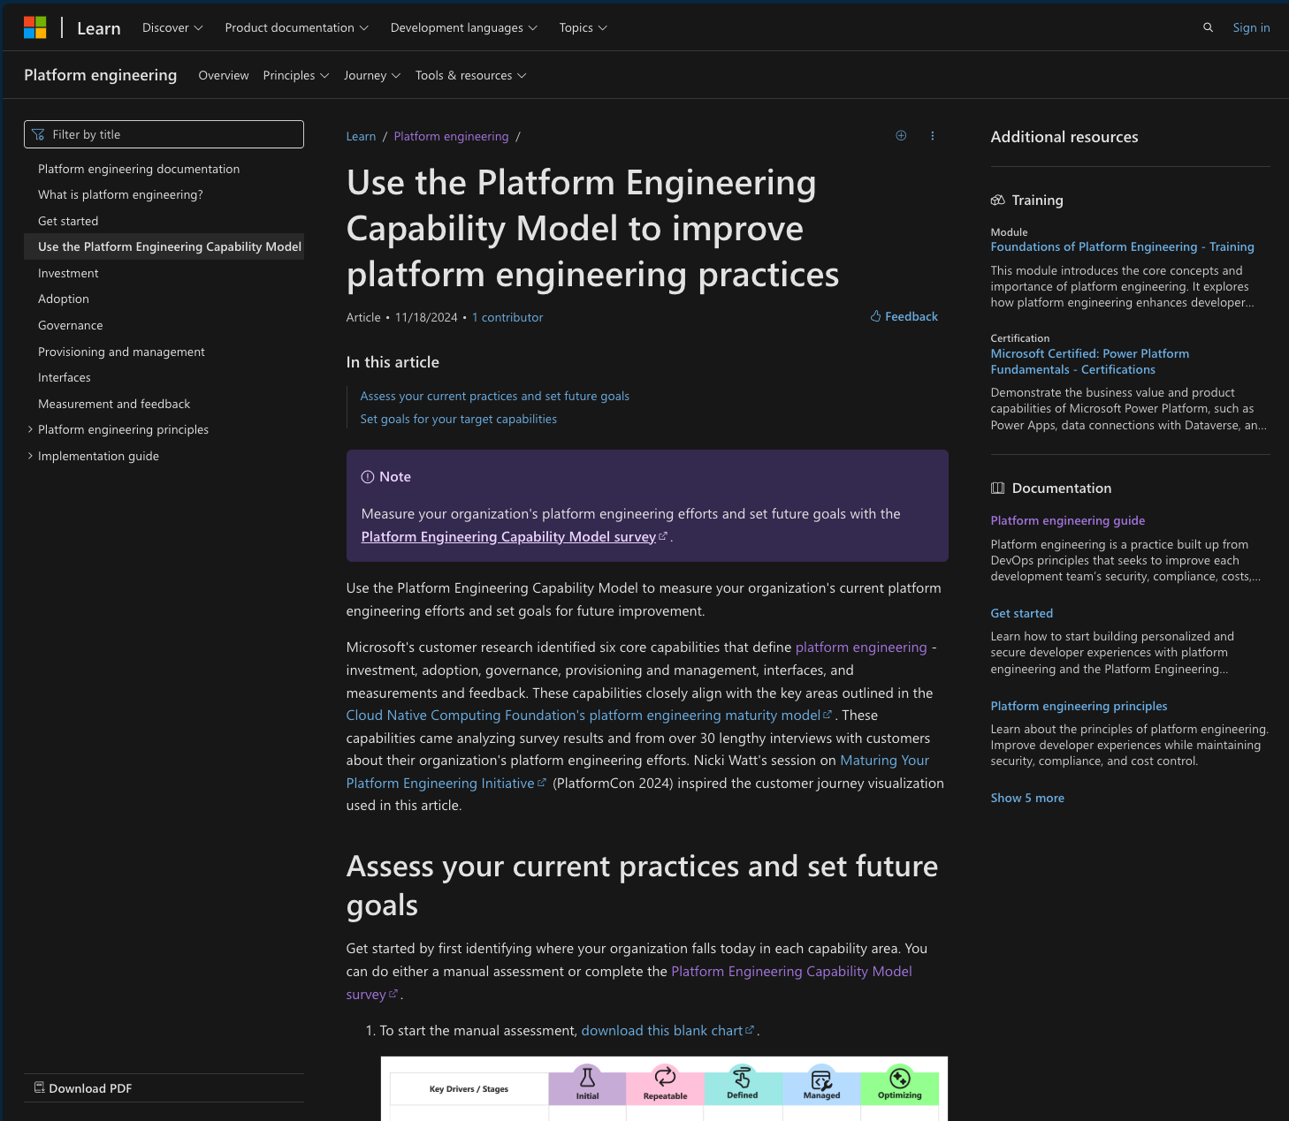
Platform Engineering Capability Model
https://aka.ms/plat-eng-learn/capability-model

Slide 18
Three Motions of Platform Engineering

Slide 19
Platform engineering motions
Start right templates
Equipping developers with self-service tools
Stay right governance
Maintaining compliance
Get right alignment
Getting compliant
Notes:
As you embark on your own platform engineering journey, you'll likely encounter three key motions:
"Start Right" focuses on equipping your developers with self-service tools, enabling them to kickstart their projects quickly while adhering to your company's best practices defined through templates and policies.
"Stay Right" is all about maintaining compliance as your projects grow and ensuring that developers continue to follow those best practices via continous automation and monitoring.
Finally, "Get Right" campaigns assist developers in bringing their existing DevOps infrastructure, code, and applications into compliance within your company's evolving standards.
But the best compliance work feels "free“ to the developer - it's automated, invisible, and so ingrained in tools and processes that much of it is embedded."

Slide 20
Key infrastructure components
Start right templates
Equipping developers with self-service tools
Workstation
App Infra
Development Environment
Deployment Environment
Notes:
First we have the development environment, or my workstation. This includes the actual machine, whether that’s something like a desktop, a virtual machine, or a GitHub Codespace, in addition to the software I use to develop code and run tests. That includes your IDEs like Visual Studio and VS Code, and any supplemental tools like Docker Desktop. Basically, your local tools that allow you to do your best work is how we encapsulate the development environment. And the second one we have is the deployment environment. This is your cloud infrastructure that makes up the application you’re working on. The compute where your code is deployed, whether that’s using a Function App, or Azure App Service, or an Azure Kubernetes Cluster. This includes your Cosmos database, your Service Bus, your AI components, and the networks they all communicate under. And this deployment environment is where you can interact with your application to do testing in real time.

Slide 21
Stay right governance
Maintaining compliance
Active control and governance at scale for your Azure resources
Apply policies at scale
Enforcement & compliance
Remediation
Apply policies to the root Management Group with control across your entire organization
Grouping through initiatives
Exemptions and safe-deployment tools
Real-time policy evaluation and enforcement
Periodic & on-demand compliance evaluation
Enforcement of configuration and resource actions
Remediate existing resources at scale
Automatic remediation resources at deployment time
Trigger Functions, Logic Apps, or web hook upon compliance state changes (via Event Grid)
Notes:
Proven tool that we rely on within Microsoft and all top 100 of Azure customers depend on Policy.
Azure Policy supports real-time enforcement and provides the compliance data at per-policy, per resource granulary.
For the rest of the session, we will discuss what makes Azure Policy so powerful and special, and how you can adopt in on a complex enterprise environment – using what we do internally within Microsoft as an example.

Slide 22
Get right alignment
Getting compliant
1
Platform Engineering | Get Right
Secure Future Initiative (SFI)
GitHub Advanced Security
Secret Scanning
Managed Identities
Dependabot
Security campaign
Pipeline migration
Cloud Defender
2
3
4
5
6
7
8
9

Slide 23
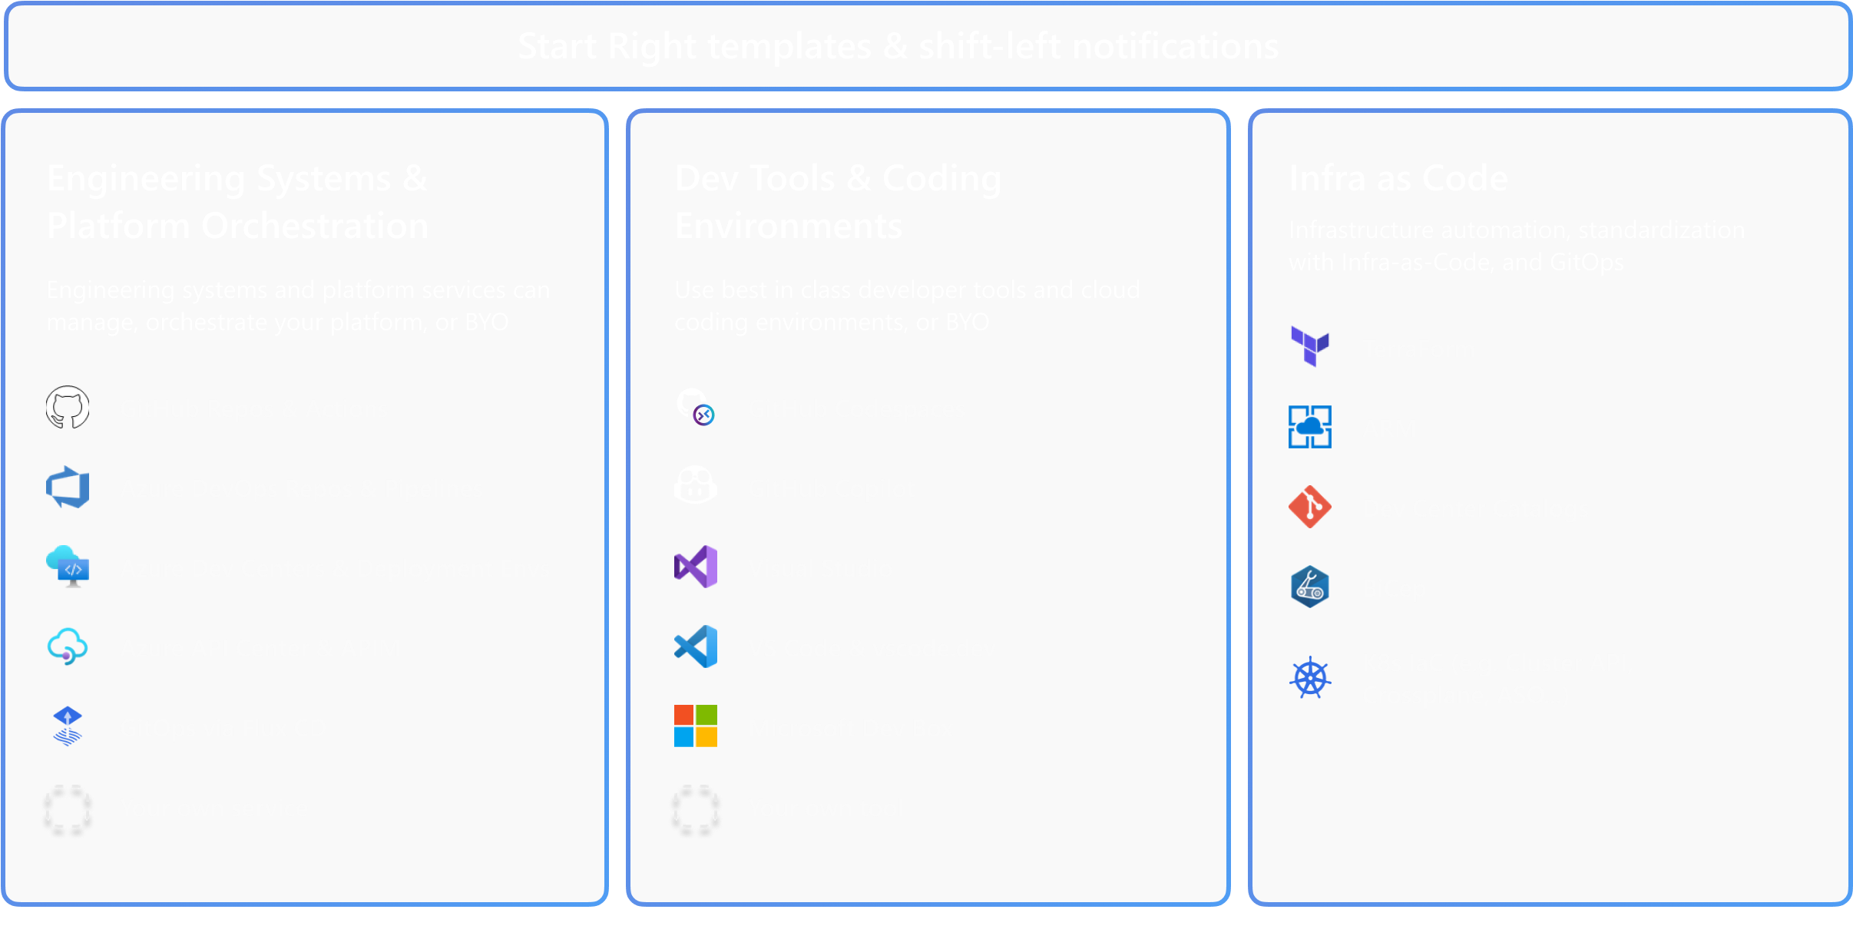
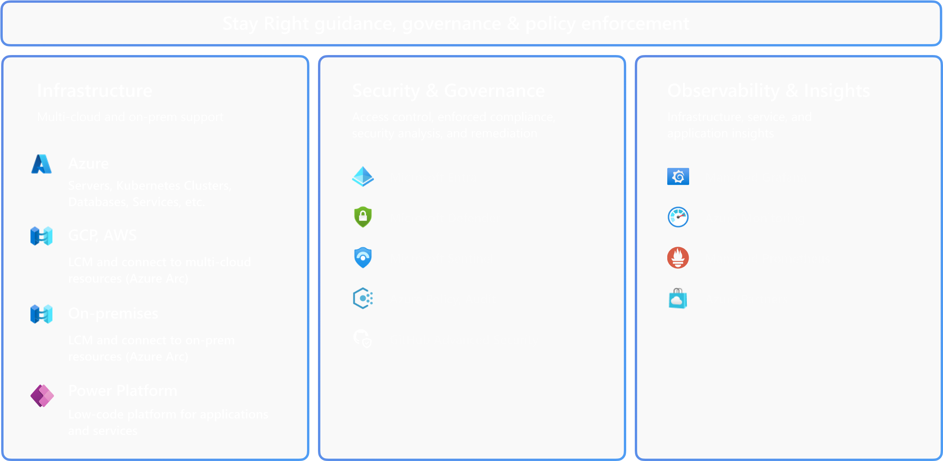
Templates, guidance, governance & policy enforcement Part 2
Deploy &
Code
Operate
Start Right templates & shift-left notifications
Stay Right guidance, governance & policy enforcement
Monitor
Build
& Observe
& Test
Continuous
Continuous
Deployment
Feedback

Slide 24
Start Right Team Development

Slide 25
Importance of managing repositories at scale
Security and auditors happy
Prevent mistakes
Repeatable
Drives consistency, reliable and efficacy
Consistently applied, with least privilege access and well logged
Have you ever worried about turning the wrong repository to Public? Or been concerned that you may be deleting the wrong repository?
Notes:
governance is an important topic for many companies so they can ensure their code meets certain standards.
This is why our colleagues at GitHub have been investing in rule sets such as repository, branch rule sets, repository tag rule sets and repository push rule sets.
But we know that it's not just about the code, and you'll want to govern the repositories themselves as well, like how they're named or preventing accidental operations like visibility changes and deletions.
We want to make at scale management of repos even more powerful. To do that we are investing in enterprise governance to ensure you can have the right policy manage the right sets of repos.
Which leads to predictable, stable, and efficient operations which makes your life easier across the DevOps lifecycle.
I’m going to talk about two new features we’re going to be releasing into public beta next month that work together to help your platform engineering teams establish your policies and enforce governance across your entire enterprise

Slide 26
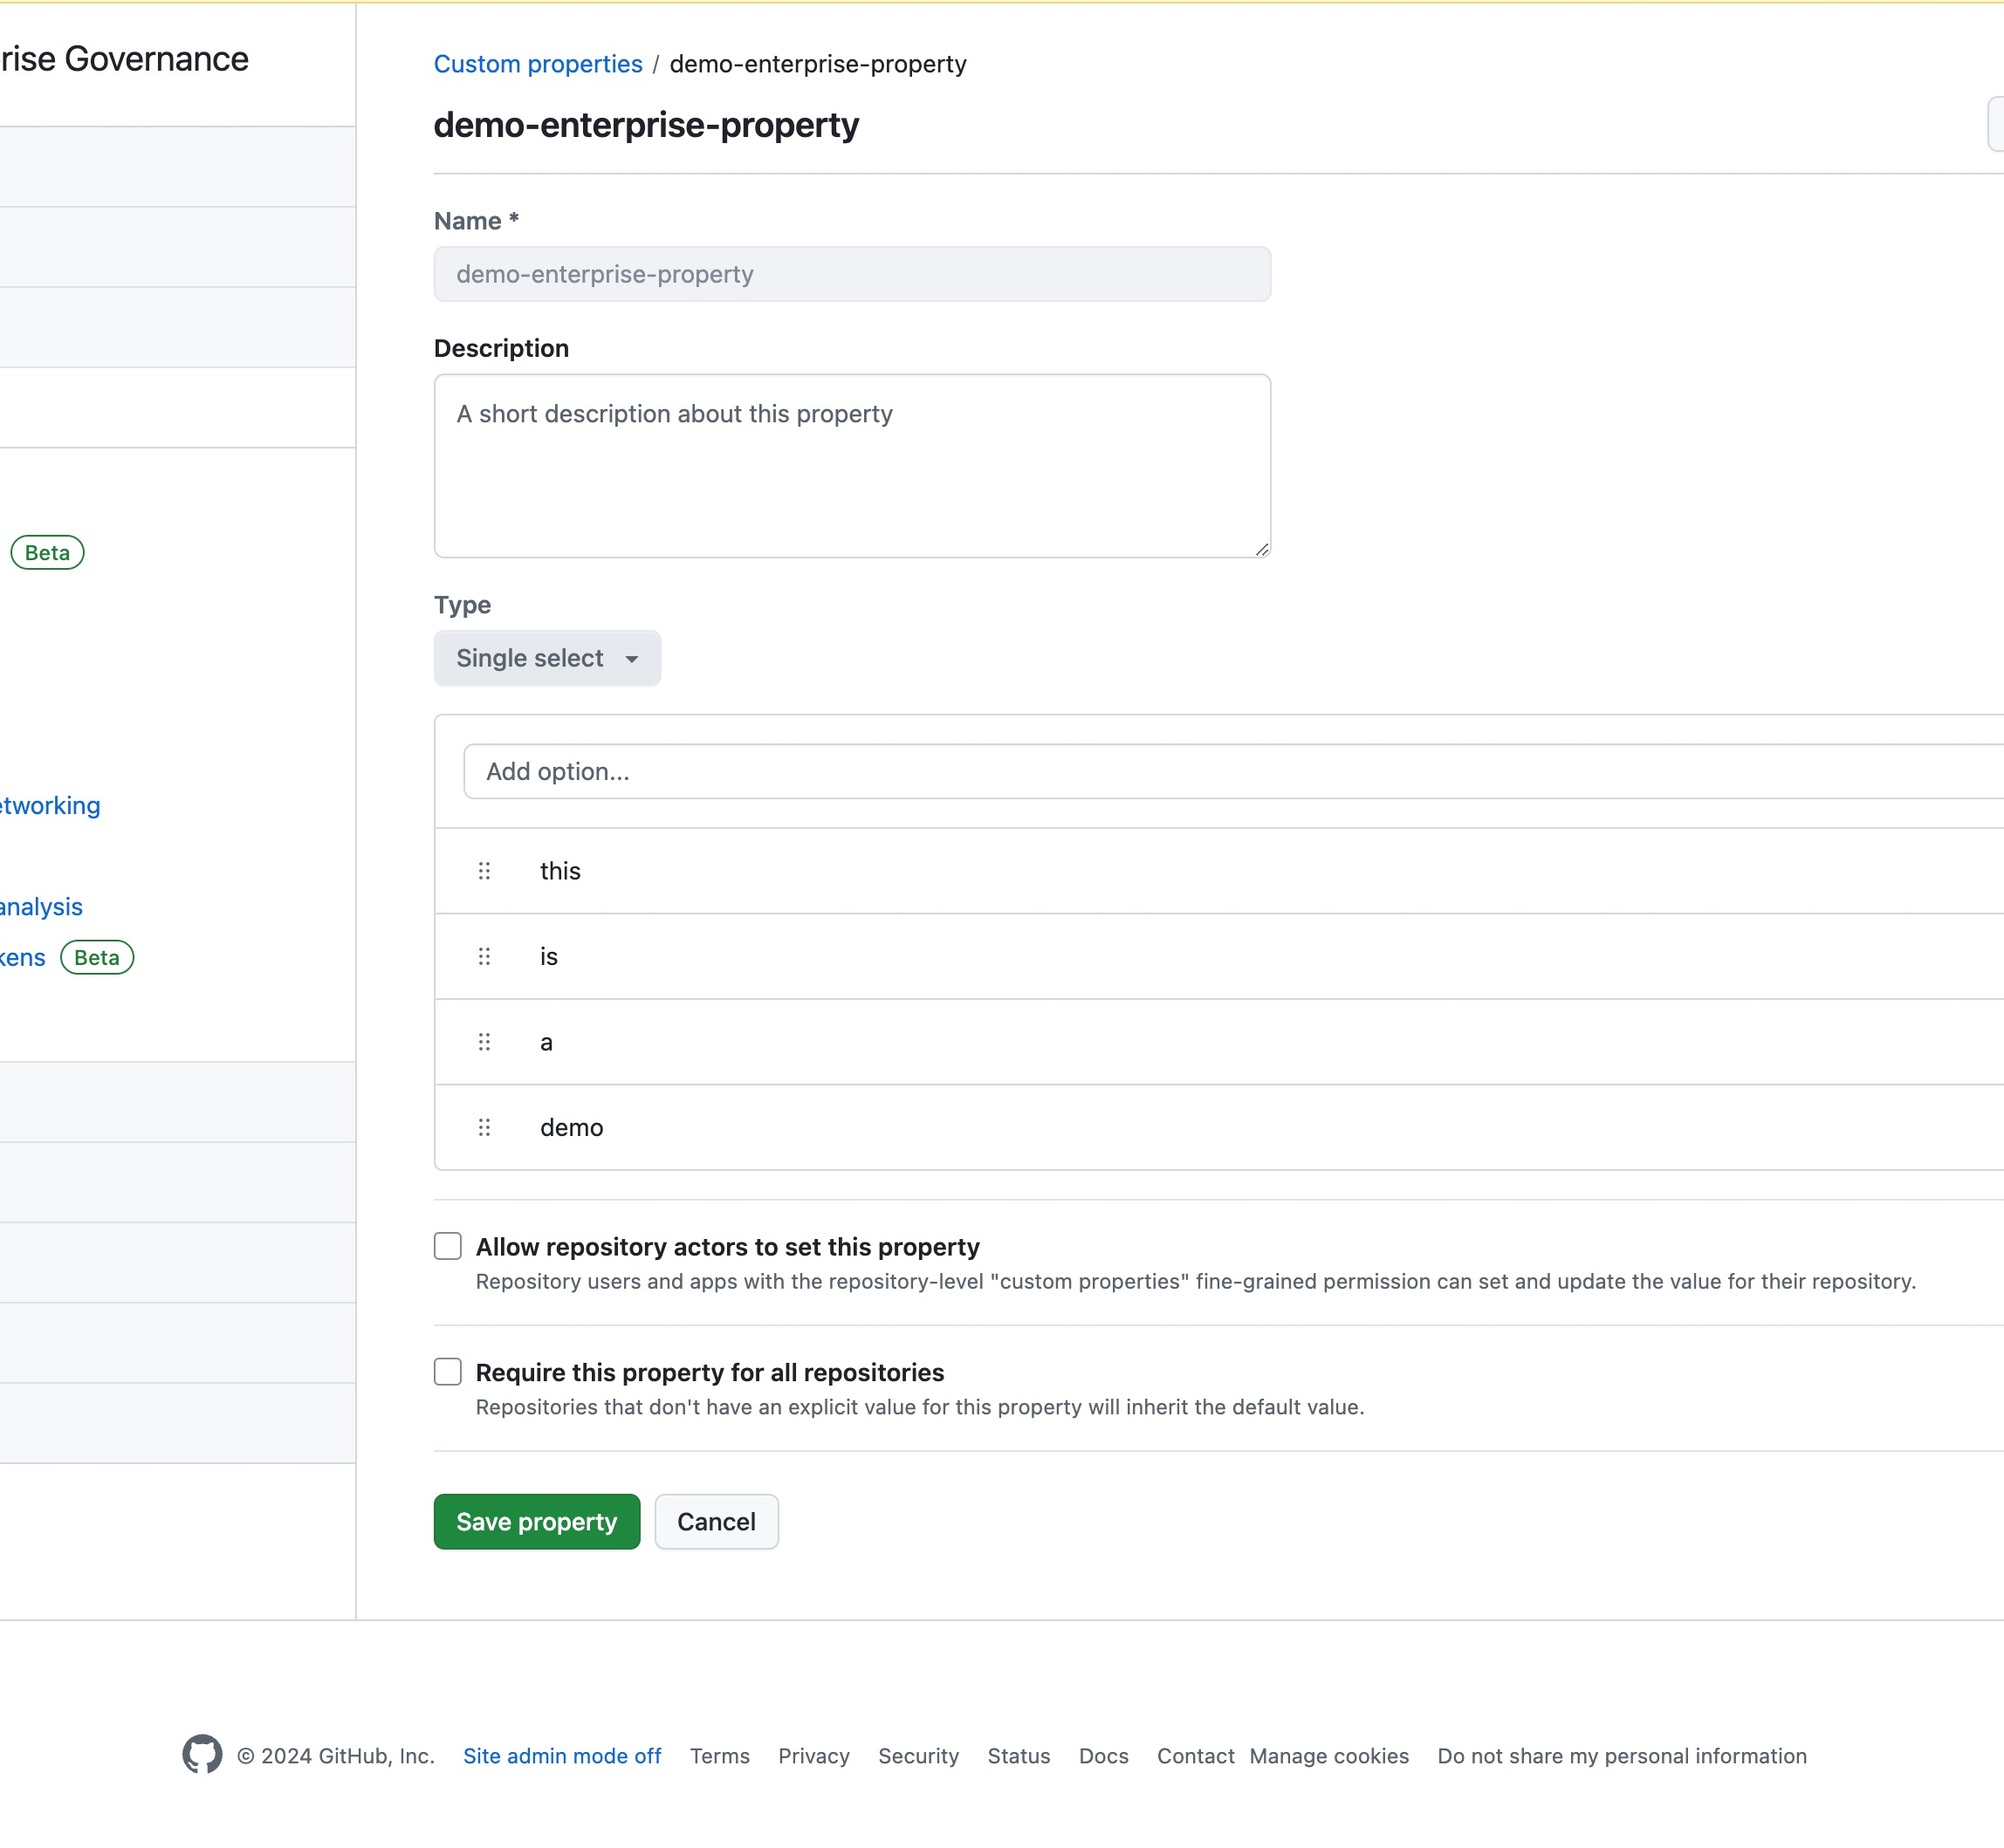
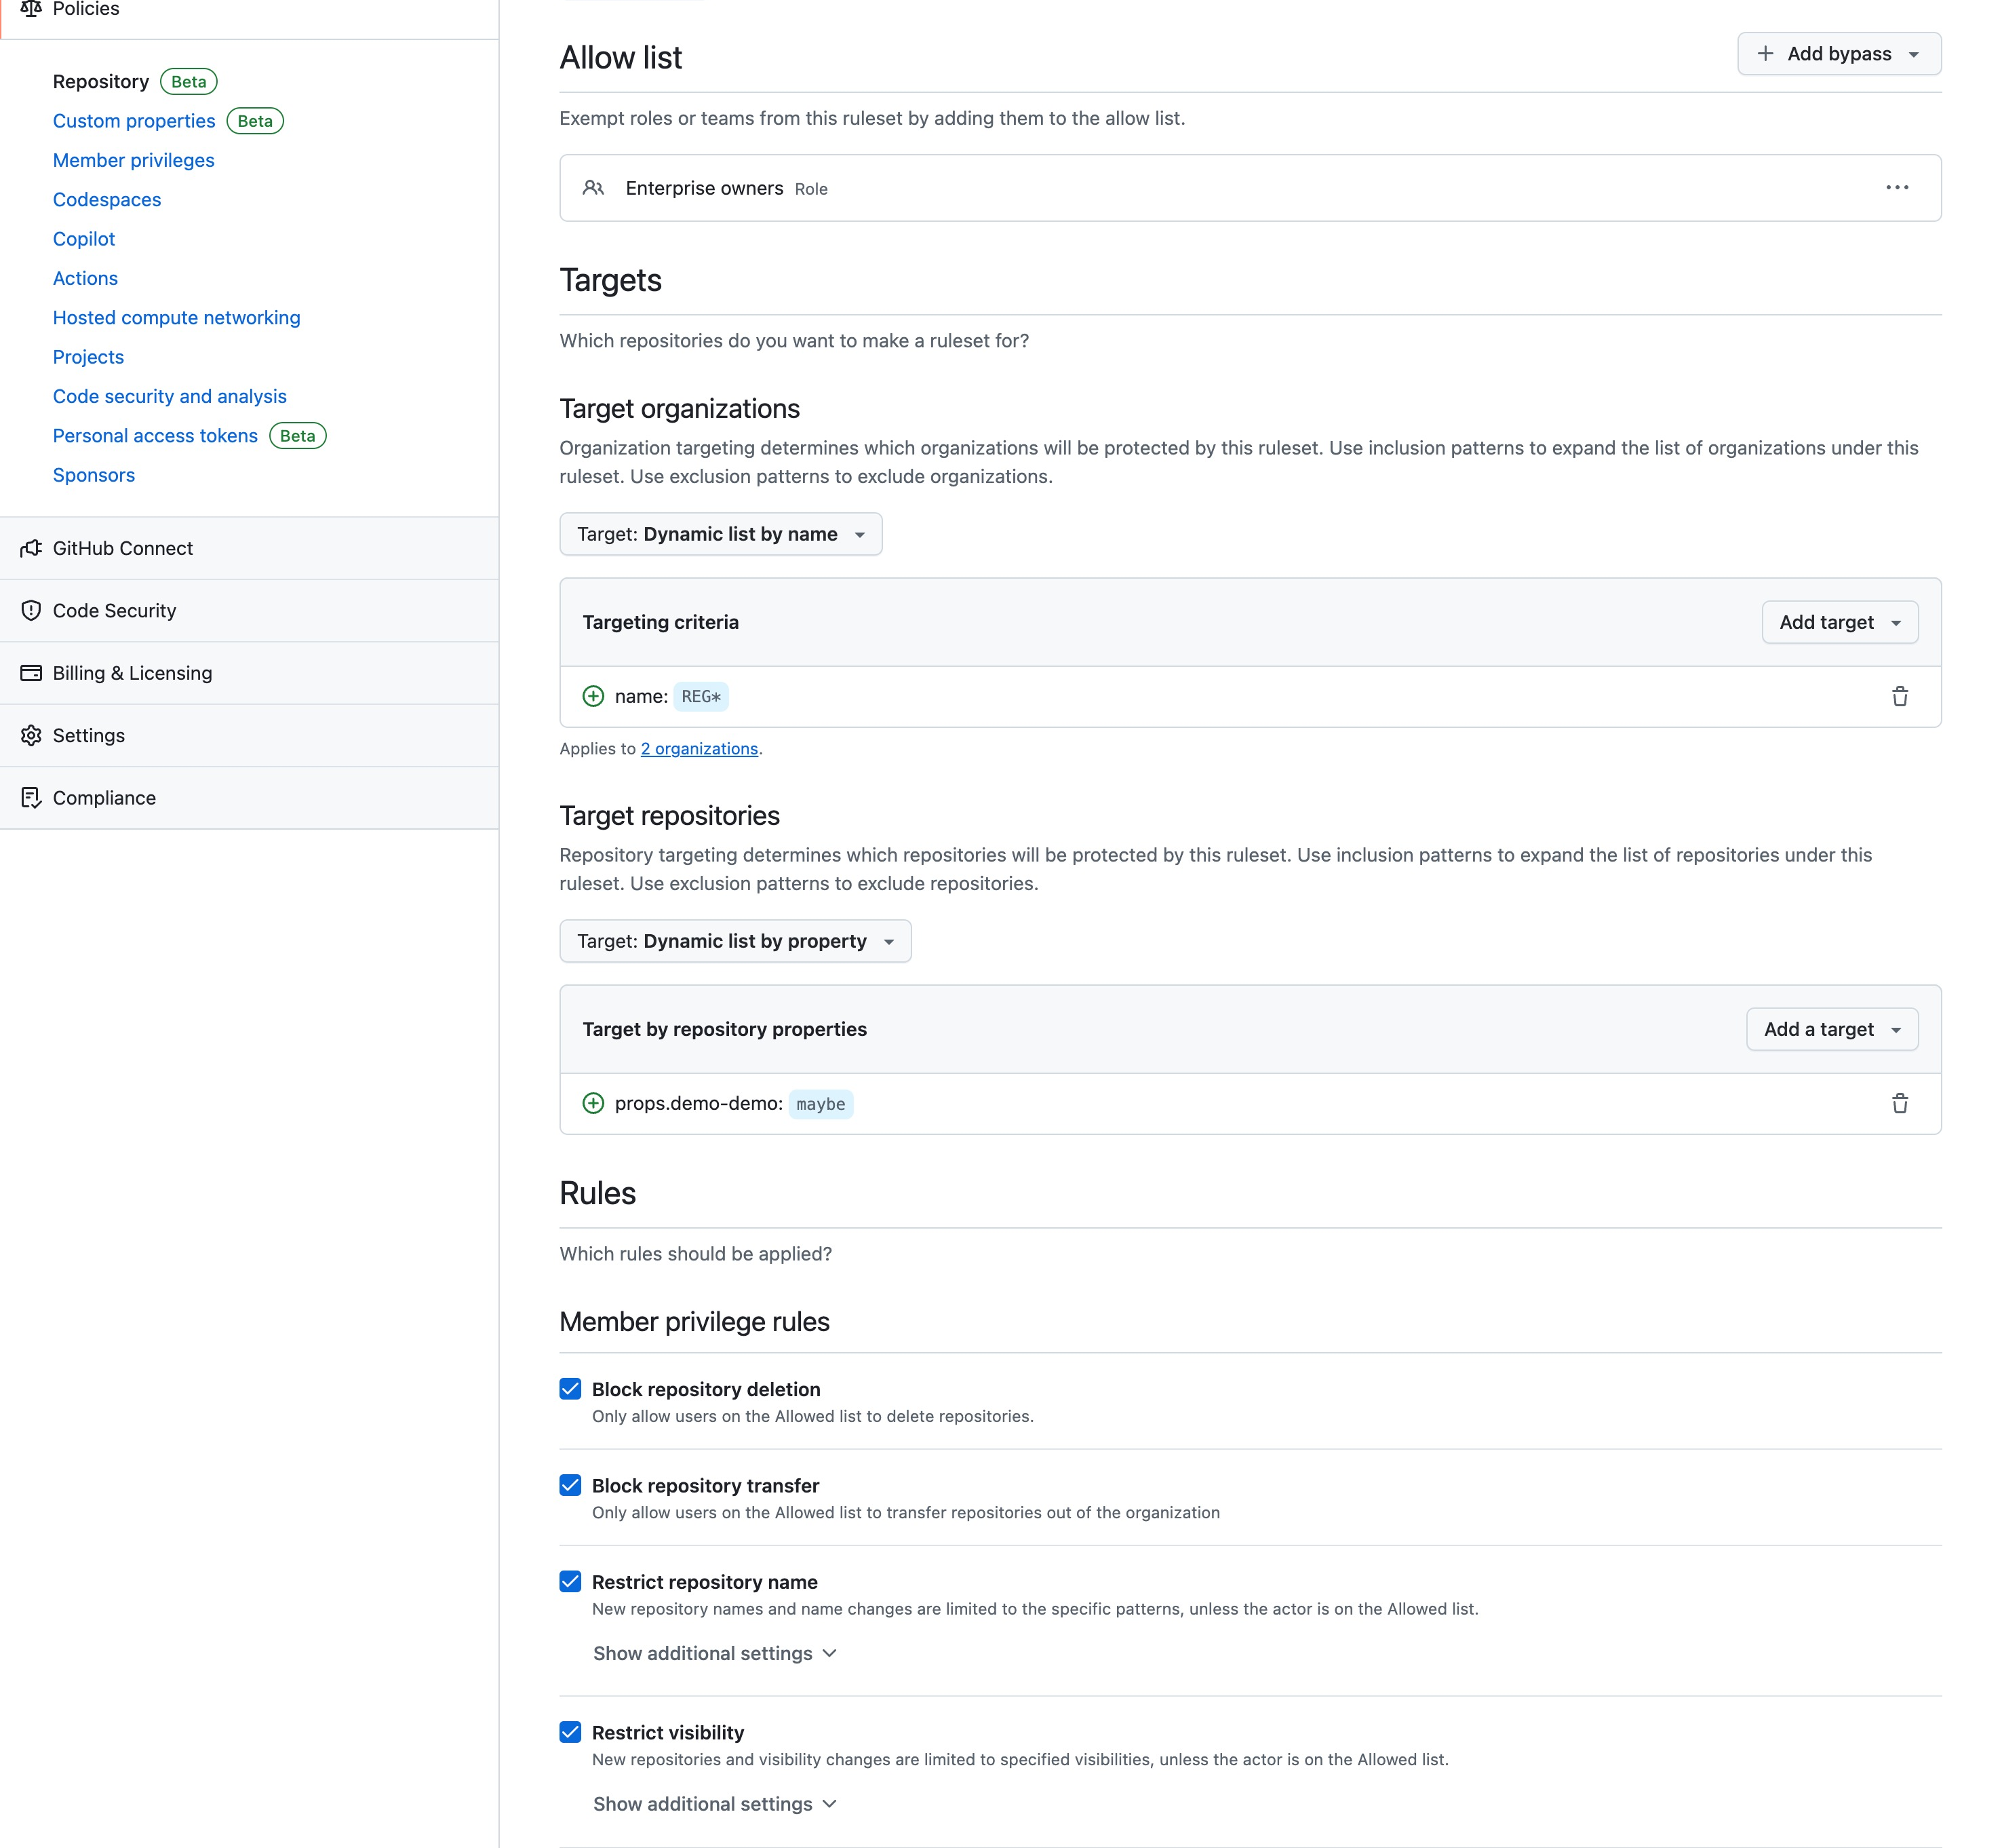
Managing repositories at scale
PRIVATE PREVIEW
PRIVATE PREVIEW
Enterprise custom properties
Allows you to have consistent properties available across all your GitHub organizations.
Enterprise repository policy
Target repository policies across your organizations.
Notes:
We’ve been working on enterprise custom properties and enterprise repository policies, a way for you to manage the configuration of your repositories at the enterprise level.
If you've used branch or push rule sets, then the experience will feel familiar.
These policies are built on top of the same framework as repository rulesets but are built to control repository lifecycle events like creation, renames, visibility and more.
Let’s dive in.

Slide 27
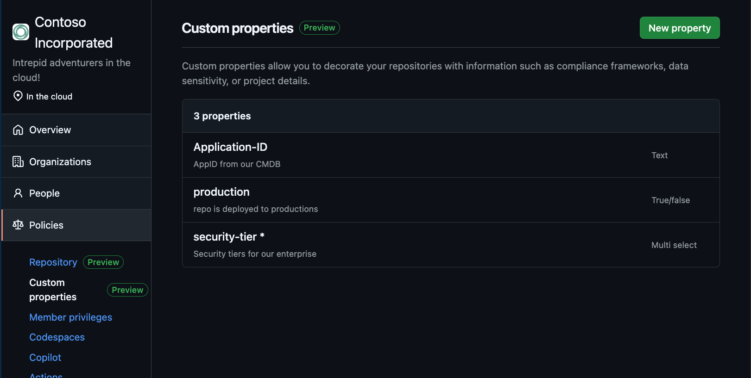
Enterprise Custom Repository Properties
Metadata for your repositories
Consistent across all organizations
Works alongside existing properties
Notes:
We are talking that key:value metadata system and giving it a literal upgrade from the organization to the enterprise.
And the best part is they work the same as your existing org properties so you can use them in the repository list view, ruleset targeting and the security overview.
This will allow you to maintain a set of properties that are consistent across all the organizations in your enterprise
Oh, and you can use them in a new way as well…

Slide 28
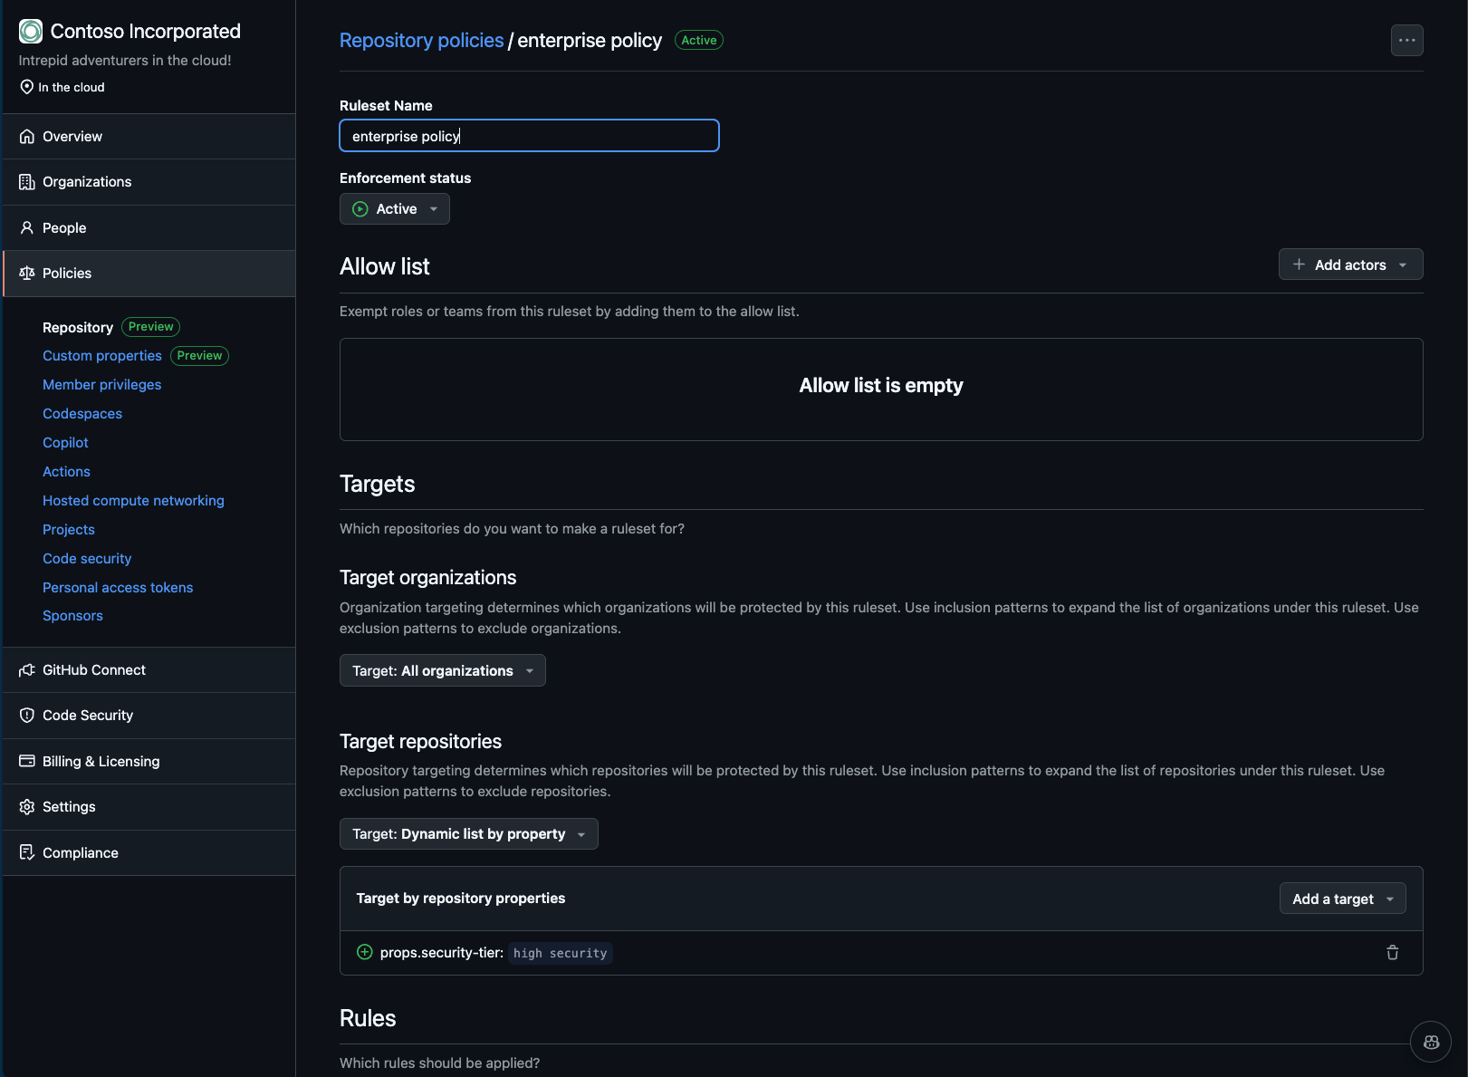
Enterprise Repository Policies
Restrict visibility
Restrict creation
Restrict deletions
Restrict transfers
Restrict name
Notes:
And that is in enterprise repository policies. This is built on top of the ruleset framework to manage the lifecycle of your repositories. So, you have similar behavior here like - an allow list to let certain folks skip these policies
- Targeting so you can apply policies as broadly across organizations as need or narrowly to select repositories using enterprise custom properties.
- and rules. We’re starting out with five rules but are looking for feedback on what additional rules would be useful to control behaviors on repos.
####Restrict visibility
- New repositories and visibility changes are limited to specified visibilities.
####Restrict creations
- Limit who can create repositories.
####Restrict deletions
- Limit who can delete repositories.
####Restrict transfers
- Limit who can transfer repositories.
####Restrict names
- Limit repo names and name changes to those that match a given regex pattern.

Slide 29
Start Right Self Service Infrastructure
Notes:
Hey everyone, right now we’re going to continue the conversation of ‘starting right’ for enterprise developers into the topic of self service infrastructure. I think we’re all aware how enterprise systems are full of governance and compliance policies, with strict rules on how cloud resources are managed and deployed, and who’s able to deploy and access the cloud. For the average developer, there’s so many hoops to jump through to have access to the right set of infrastructure to deploy and test their products’ applications, and that process can take days or weeks and cause a lot of pain points for the developer who’s looking to jump in right away. I’m excited to talk about some of the solutions we have to transform the way developers can gain quick and intuitive access to this infrastructure, while still following all enterprise guardrails put in place.

Slide 30
Key infrastructure components
Workstation
App Infra
Development Environment
Deployment Environment
Notes:
First we have the development environment, or my workstation. This includes the actual machine, whether that’s something like a desktop, a virtual machine, or a GitHub Codespace, in addition to the software I use to develop code and run tests. That includes your IDEs like Visual Studio and VS Code, and any supplemental tools like Docker Desktop. Basically, your local tools that allow you to do your best work is how we encapsulate the development environment. And the second one we have is the deployment environment. This is your cloud infrastructure that makes up the application you’re working on. The compute where your code is deployed, whether that’s using a Function App, or Azure App Service, or an Azure Kubernetes Cluster. This includes your Cosmos database, your Service Bus, your AI components, and the networks they all communicate under. And this deployment environment is where you can interact with your application to do testing in real time.

Slide 31
Onboarding journey for a new project
Developer workstations
Procure corporate laptop
Find team onboarding wiki
Resolving broken links
Working around out-of-date instructions
Request access to source code
Request access to cloud resources
Install OS
DevTest App infrastructure
Provide details about the application
Raise a ticket to request a new environment
Find out how to get access to a new test environment
Open & rebuild application to populate caches
Configure local network settings & VPN
Install & configure developer tools & SDK
Clarify requirements with platform engineers
Go back and forth to align on requirements
Wait for admins to create and configure infrastructure
Validate whether the app code works on the test environment
Wait for admins to update or fix the infra configuration
Finally get access to the working infrastructure
Repeat the process for a new test environment
Notes:
Now getting these two key components up to speed for new developers and new projects is not typically a fast process. For anyone that’s started a new job recently, I know you have some horror story of getting access to the source code repository, or certain company documents, or even just being able to access the Teams channels, right? [pause] For a developer workstation, that means getting your laptop, following a possibly outdated setup wiki, configuring all the local network settings and developer tools, downloading the right .NET core and .NET SDK, downloading the source code repo once you finally get access.
For that deployment environment, once you’re finally ready to start testing code, that means requesting access to those new cloud resources and starting a back and forth with the platform engineer, waiting for the resources to be created after approval, ensuring those resources were created correctly and the code is able to be ran on the environment, waiting for the fixes because something never goes right the first time, and then finally getting access to it. And then, once you’re wrapped up with that environment, we’ll need to start that process all over again.
This whole process can take weeks to the point of that PR making it out to the rest of the team. There has to be a better way, right?

Slide 32
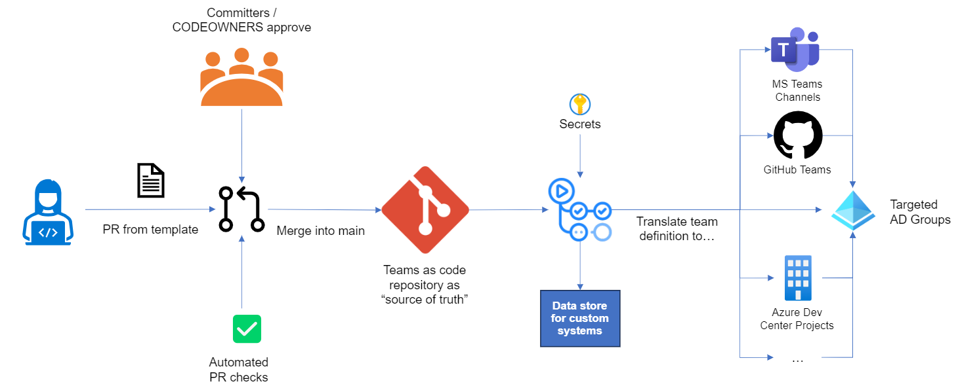
Demo Teams As Code
Notes:
So lets talk about some interesting ways that organizations are using PE
https://github.com/github/entitlements/blob/master/github.com/octodemo/org/member.txt
https://github.com/github/entitlements/pull/101183

Slide 33
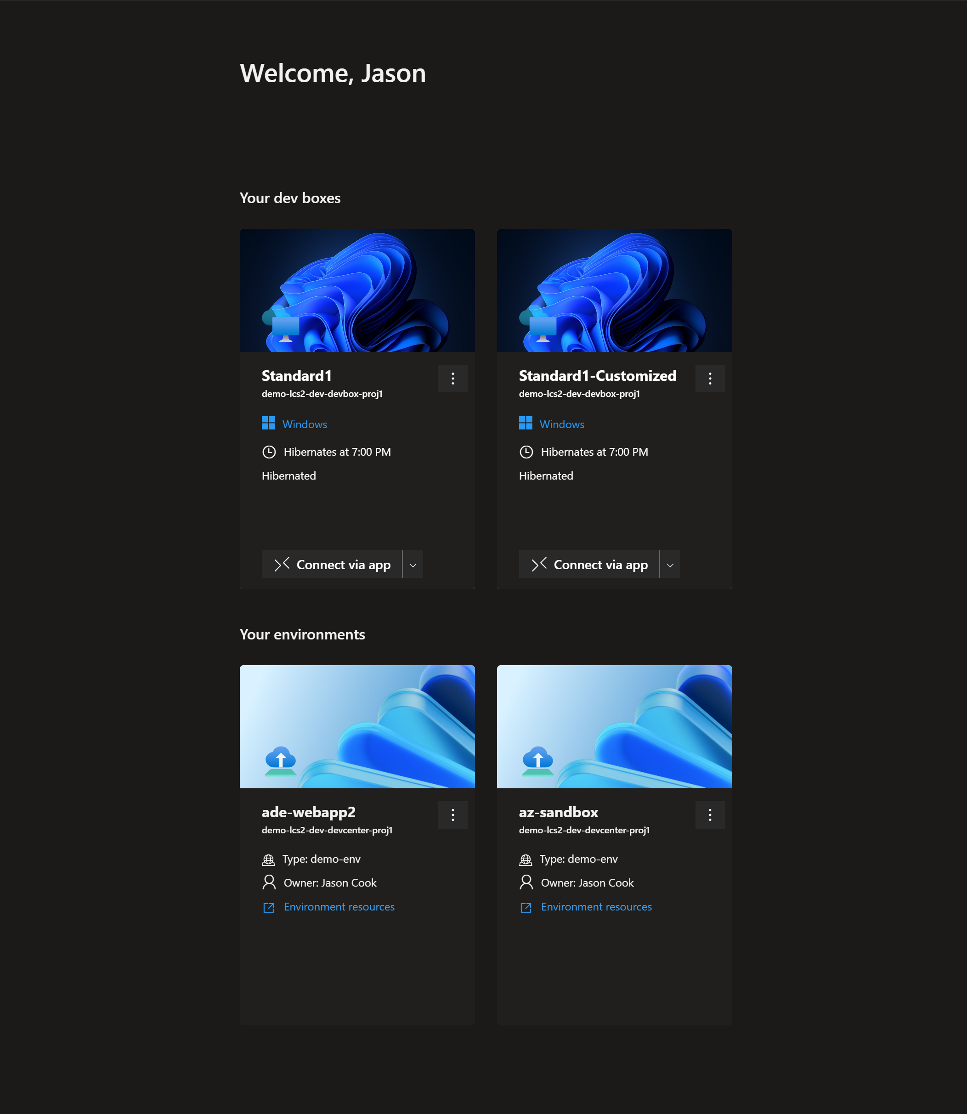
Demo DevBox Self Service
Notes:
https://github.com/github/entitlements/blob/master/github.com/octodemo/org/member.txt
https://github.com/github/entitlements/pull/101183

Slide 34
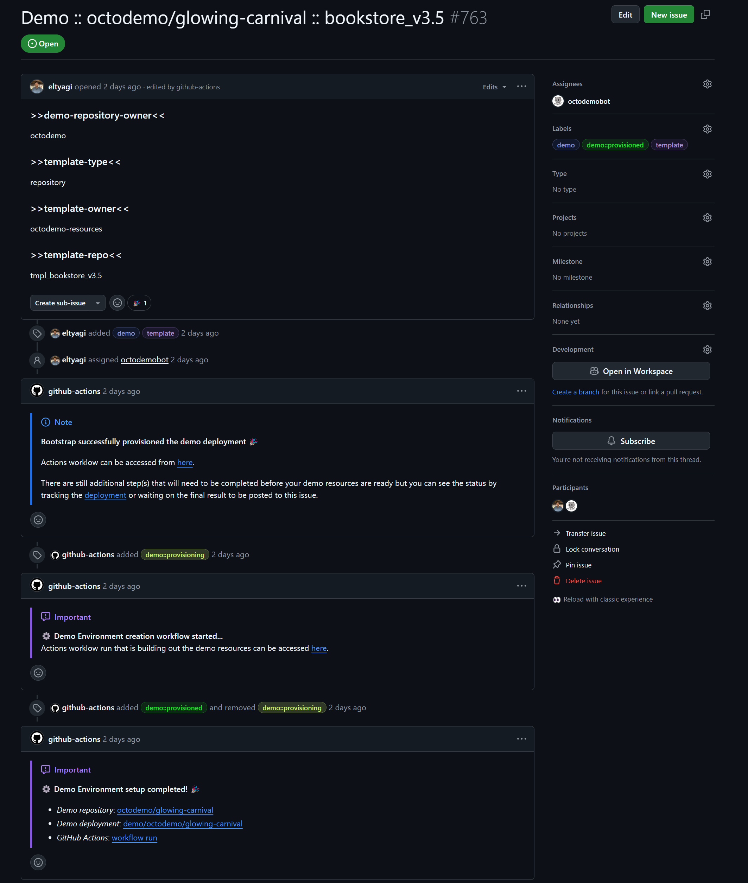
Demo IssueOps
Notes:
https://github.com/octodemo/bootstrap/issues
https://github.com/octodemo/bootstrap/issues/1345

Slide 35
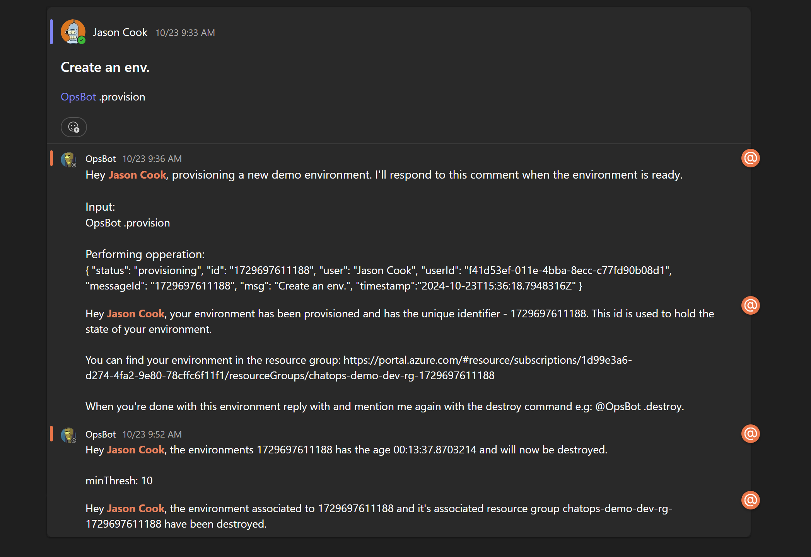
Demo ChatOps

Slide 36
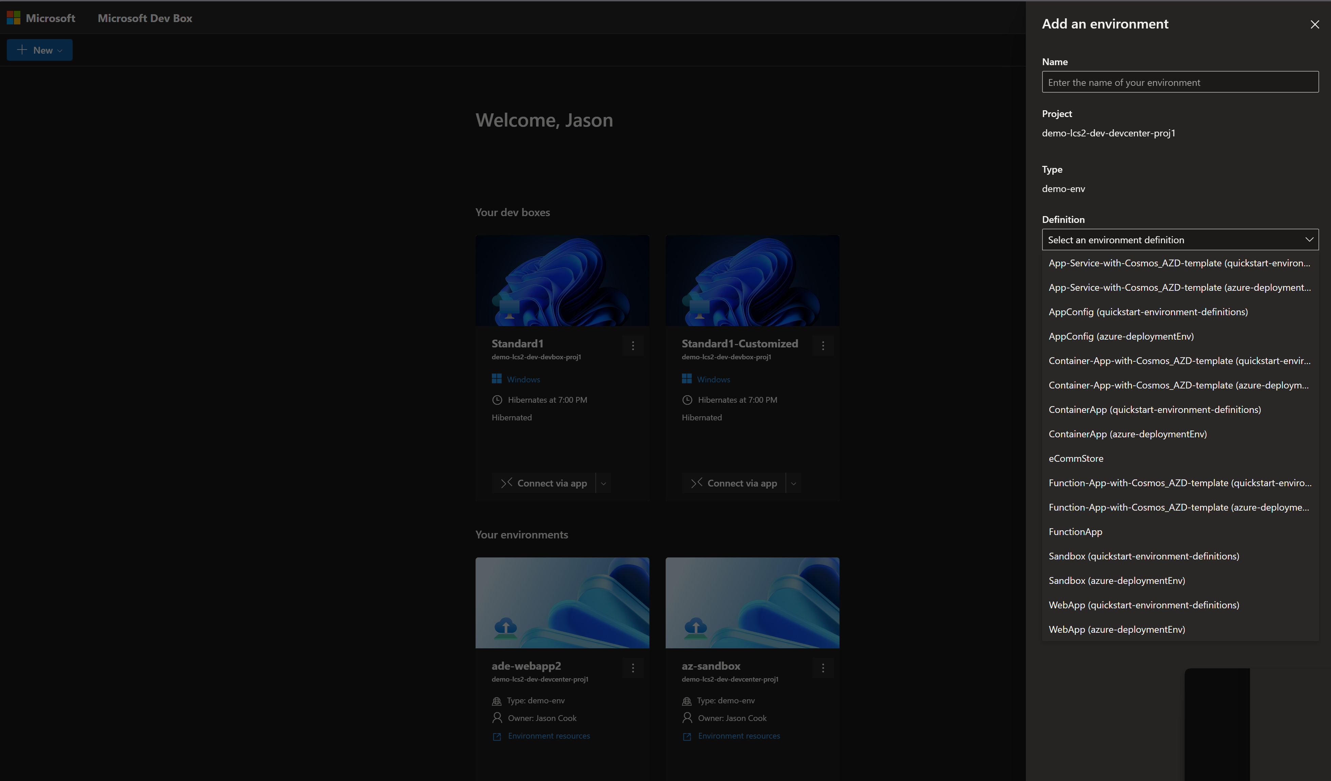
Demo Azure Deployment Environments

Slide 37
Stay Right: Codifying your guardrails
Notes:
Hello, my name is Liz. I am a product manager leading the Azure Governance team, responsible for services we are about to talk about such as Azure Policy, Management Groups, and tags.
Let’s talk about how to make your environment stay right that is compliant, secure, and well-governed.
There are THREE types challenges that arise in creating a durable environment.

Slide 38
Challenges with Stay Right
Environment constantly goes through changes
Definition of what is ‘right’ continues to evolve
Environment grows and becomes complex
Notes:
One is that your environment constantly goes through changes, with resources getting added, updated, deleted, and moved. And it’s important that these changes are done with the same speed of agility with the policies applied.
Second is that our understanding of what we need to do to create well-governed environment evolve over time. As there are new services and practices, we need to introduce new policies accordingly. For example – We talk about the importance of using Managed Identity instead of shared key. But a few years ago, Managed Identity didn’t even exist for us to enforce.
Third is that hopefully your Azure environment is continuing to grow over time. So you really need the tool that can allow you to stay right at-scale.
The tool we have to tackle these challenges is Azure Policy.

Slide 39
How Azure Policy can help
Active control and governance at scale for your Azure resources
Apply policies at scale
Enforcement & compliance
Remediation
Apply policies to the root Management Group with control across your entire organization
Grouping through initiatives
Exemptions and safe-deployment tools
Real-time policy evaluation and enforcement
Periodic & on-demand compliance evaluation
Enforcement of configuration and resource actions
Remediate existing resources at scale
Automatic remediation resources at deployment time
Trigger Functions, Logic Apps, or web hook upon compliance state changes (via Event Grid)
Notes:
Proven tool that we rely on within Microsoft and all top 100 of Azure customers depend on Policy.
Azure Policy supports real-time enforcement and provides the compliance data at per-policy, per resource granulary.
For the rest of the session, we will discuss what makes Azure Policy so powerful and special, and how you can adopt in on a complex enterprise environment – using what we do internally within Microsoft as an example.

Slide 40
Policy as Code
All Policy objects are modeled as resources. They are JSON files that can be deployed using CICD pipeline.
Definition
Initiative definition
Assignment
Exemption
Remediation task
Notes:
Important that policy is defined as code

Slide 41
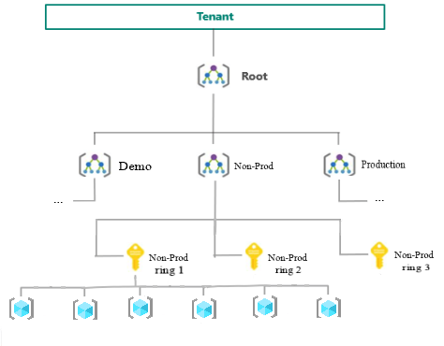
Organizing your environment
An application should be contained within a subscription.
The management group hierarchy should represent separate environments (dev, non-prod, prod).
MGs allow for at scale management of role-based access control and policy management. This is critical for proper safe deployment of Policy.
Tags can store important business information such as cost code, owner and rings for deployments, etc.
Leverage Policy for tag management such as requiring tags on a resource or populating tags at-scale.
Notes:
Important to organize environments correctly

Slide 42
Get Right: Working towards compliance

Slide 43
Get Right
1
Platform Engineering | Get Right
Secure Future Initiative (SFI)
GitHub Advanced Security
Secret Scanning
Managed Identities
Dependabot
Security campaign
Pipeline migration
Cloud Defender
2
3
4
5
6
7
8
9

Slide 44
Secure Future Initiative (SFI)
Secure by design
Secure by default
Secure operations
Security culture and governance
Protect identities and secrets
Protect tenants and isolate production systems
Protect networks
Protect Engineering systems
Monitor and detect threats
Accelerate response and remediation
Continuous improvement
Paved path
Standards
Notes:
What we’ve done here at MS

Slide 45


GitHub Advanced Security (GHAS)
Get Right and preventing vulnerabilities in your code
Embed Security into your developers’ workflow
Provide ways to fix security findings in real-time
Empower developers with just-in time education
Notes:
GHAS does this in 3 unique ways:
Embedding security natively into the developer workflow
Providing security findings and fixes in real-time
And empowering developers with education on the vulnerabilities

Slide 46
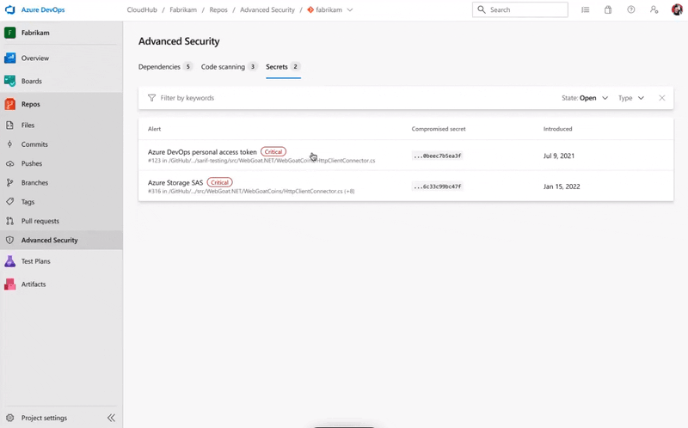
Secret Scanning
Find and Manage hard-coded secrets
Proactively identify secrets as early as possible
Finds secrets the moment they are pushed to your repo (GitHub or Azure DevOps) and immediately notifies developers when they are found.
Detect more than 200+ token types from more than 100 partners
For every commit made to your repository and its full git history, we'll look for secret formats from our secret scanning partners.
Notes:
Both the Verizon Data Breach Investigations Report and the Ponemon Institute have consistently identified stolen or compromised credentials as the primary cause of breaches for two consecutive years, naming them not only the most prevalent but also the costliest for organizations to resolve.
To combat secret exposure, companies leverage GitHub Secret Scanning to meticulously comb through their repositories, identifying any passwords, tokens, encryption keys, or other sensitive information that are inadvertently leaked.
By default, secret scanning alerts users only after a secret has been committed. However, with Push Protection enabled, you gain proactive control. This feature allows you to utilize secret scanning to prevent supported secrets from being pushed into your organization or repository, mitigating risks before they arise.
Moreover, users have the flexibility to define custom patterns tailored to their organization's specific needs. This capability ensures that even internal secrets unique to your organization can be identified and prevented from exposure.
Furthermore, we've introduced the GitHub Actions Secrets API, offering a secure method to store and retrieve passwords and encryption keys. This reduces the risk of inadvertently exposing sensitive information in publicly available scripts, providing an additional layer of protection.
[For sellers - additional content for sellers]
Instead of blocking commits entirely, secret scanning provides users with options to manage potential issues effectively. For instance, if users need to commit a placeholder secret for testing purposes, they can easily confirm its nature and proceed. Similarly, if they encounter a false positive, they can swiftly report it and continue with their commit.
Additionally, developers have the option to acknowledge and address issues later, albeit with full awareness of associated risks. Opting for this route triggers a security alert and notifies repository admins, ensuring accountability. Crucially, GitHub maintains a detailed log of these decisions, including any context provided by the user at the time.
If a user disregards warnings and proceeds with pushing a secret, the system maintains a level of accountability. It guides users with clear prompts, explanations, and options. This intuitive approach reduces the need for extensive training or documentation, empowering developers of all levels to navigate the process.
Link to GitHub Actions Secrets API
https://docs.github.com/en/rest/actions/secrets

Slide 47
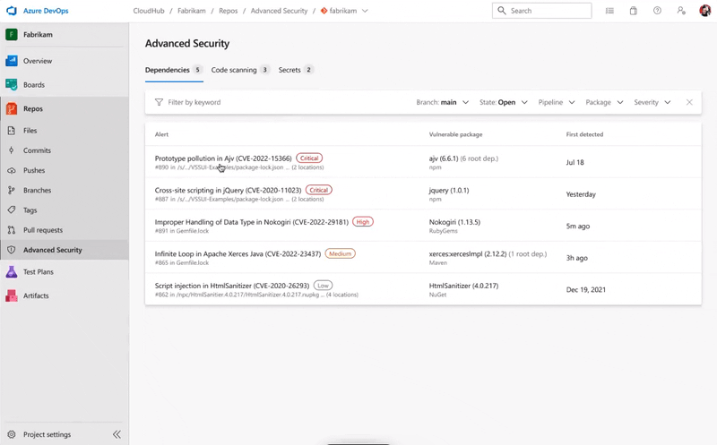
Dependency Scanning
Provide visibility into vulnerable and out-of-date dependencies
Automated security alerts
Keep your projects secure and up to date by monitoring them for vulnerable and out-of-date components.
Integrated with developer workflow
Dependency Scanning integrates directly into the developer workflow for a frictionless experience and faster fixes.
Rich vulnerability data
GitHub tracks vulnerabilities in the GitHub Advisory Database, the 2nd largest CVE issuer in the world after MITRE.
Notes:
Dependency scanning identifies open-source components utilized within your source code and ascertains if any associated vulnerabilities exist.
Each vulnerable component identified during the scanning process is meticulously logged within the build log and is displayed as an alert within the Advanced Security tab. Notably, only advisories reviewed by GitHub and integrated into the GitHub Advisory Database prompt the creation of dependency scanning alerts. Additionally, the build log conveniently includes a direct link to each individual alert, facilitating further investigation. For comprehensive details regarding each alert, users may refer to the "Fixing dependency scanning alerts" resource.
Furthermore, the build log furnishes essential insights into each identified vulnerability. These insights encompass details such as severity level, affected component, vulnerability title, and associated CVE information.

Slide 48
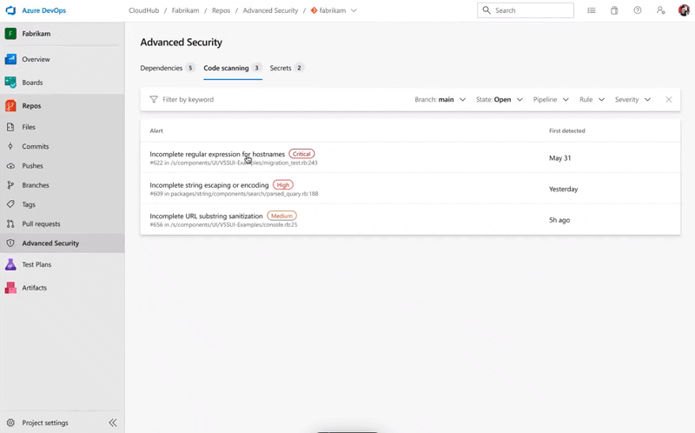
Code Scanning
Find and fix vulnerabilities as you code
CodeQL
Turns source code into relational data that can be queried for vulnerabilities
Find and fix vulnerabilities fast
Find and fix vulnerabilities before they are merged into the code base with automated scans.
Community of top security experts
Your projects are powered by world-class security teams. Use queries created by the security community in your projects.
Integrated with developer workflow
Integrate security results directly into the developer workflow for a frictionless experience and faster development.
Notes:
Code scanning powered by CodeQL employs robust static analysis to proactively identify and address vulnerabilities during the development process. By converting source code into relational data, CodeQL facilitates efficient vulnerability detection through automated scans. These scans occur before code merges into the base, ensuring vulnerabilities are addressed early in the development lifecycle. Leveraging queries created by a community of security experts, GHAzDO seamlessly integrates security results into the developer workflow, fostering faster development without compromising security.
Integrated directly within Azure DevOps, this feature presents results within the familiar Azure DevOps UI, enabling collaboration and facilitating prevention and remediation efforts. This ensures developers can detect, prevent, and fix vulnerabilities while coding, minimizing disruption to their workflow.
Supporting a wide array of languages and frameworks, Code Scanning also offers advanced vulnerability and variant analysis, along with comprehensive reporting functionalities to meet compliance and regulatory requirements. You can also specify additional queries or query packs to be run and change or disable the default CodeQL queries. By providing actionable insights and facilitating collaboration within the development environment, Code Scanning empowers teams to prioritize security without sacrificing efficiency or agility.
[Note for seller]
Animation is showing example of a C# Vulnerability - Exposing sensitive data to the end user - see query here

Slide 49
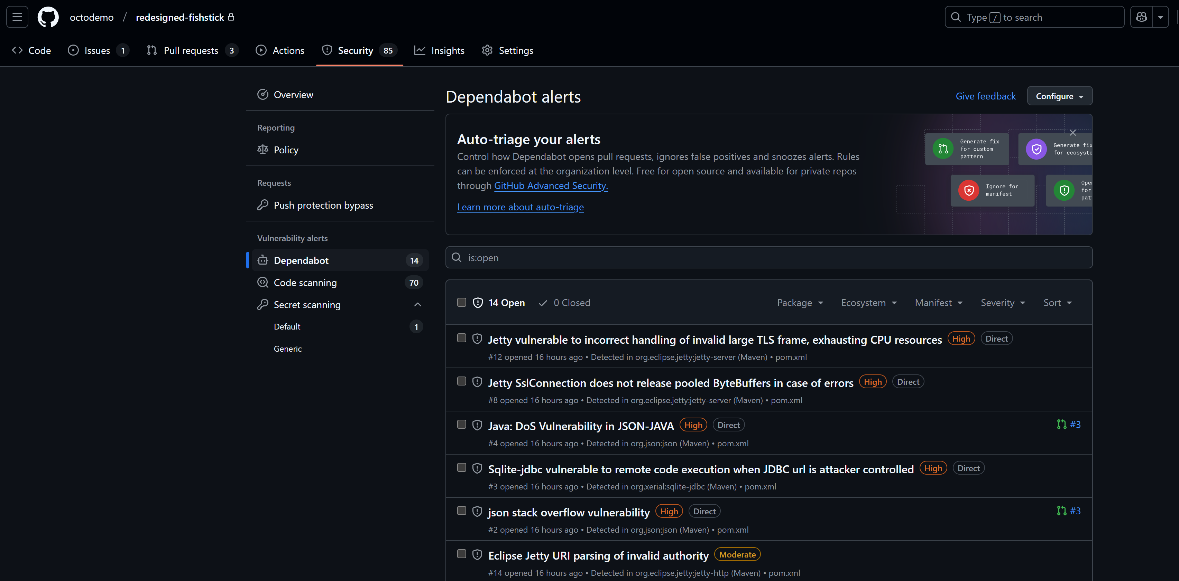
Demo GHAS
Notes:
https://github.com/octodemo/redesigned-fishstick/security/dependabot

Slide 50
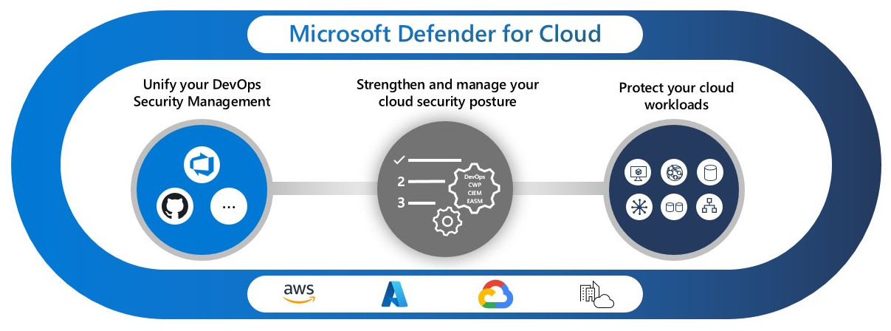
Microsoft Defender for Cloud
Empower DevSecOps models with Defender for Cloud
Unify visibility of DevOps security posture and minimize blind spots within a single pane of glass and get context-driven remediation guidance for code fixes. Integrating with Defender for Cloud helps organizations prioritize critical code fixes and keeps teams focused on emerging threats by reducing security issues before they reach production environments.
View alerts from GitHub and Azure DevOps in one unified place, allowing maximum visibility into your application security posture.
Notes:
https://portal.azure.com/#view/Microsoft_Azure_Security/SecurityMenuBlade/~/DevOpsSecurity
Any successful application security program involves effectively communicating alerts to the broader security team. GitHub Advanced Security for Azure DevOps connects with Microsoft Defender for Cloud to further empower organizations and their DevSecOps models:
With Defender for Cloud, you can:
Unify visibility of DevOps security posture: Minimize blind spots by consolidating insights into your DevOps security posture across various platforms, providing a comprehensive overview in a single pane of glass.
Strengthen cloud resource configurations in code: Addressing potential vulnerabilities and risks before they impact production environments.
Receive context-driven remediation guidance for code fixes: Leverage security intelligence and contextual information from code to cloud, enabling faster and more informed remediation efforts within your codebase.
This integration not only streamlines security operations but also empowers teams to proactively address security concerns throughout the development lifecycle, ultimately enhancing the overall security posture of the organization.

